Slide 1

















1

Slide 2
2
2-2 Effect of Temperature on Resistance
The effect of rise in temperature is:
to increase the resistance of pure metals. The increase is large and fairly regular for normal ranges of temperature.
to increase the resistance of alloys, though in their case, the increase is relatively small and irregular.
to decrease the resistance of electrolytes, insulators (such as paper, rubber, glass, mica etc.) and partial conductors such as carbon.
2-3 Temperature Coefficient of Resistance
Let a metallic conductor having a resistance of 𝑅_{𝑜} at 0°C be heated of 𝑡°C
and let its resistance at this temperature be 𝑅_{𝑡}. Then, considering normal ranges of temperature, it is found that the increase in resistance ∆𝑅 =
𝑅_{𝑡} − 𝑅₀ depends
directly on its initial resistance
directly on the rise in temperature
on the nature of the material of the conductor.
Or 𝑹_{𝒕} − 𝑹_{𝟎} ∝ 𝑹 × 𝒕 or 𝑹_{𝒕} − 𝑹_{𝟎} = 𝜶 𝑹_{𝟎} 𝒕 (𝑖) Where α (alpha) is a constant and is known as the temperature coefficient of resistance of the conductor.
Rearranging Eq. (i), we get 𝛼 = ^{𝑅𝑡−𝑅0} =
∆𝑅
𝑅₀×𝑡 𝑅₀×𝑡
If 𝑅₀ = 1Ω, 𝑡 = 1°𝐶, 𝑡ℎ𝑒𝑛 𝛼 = ∆𝑅 = 𝑅_{𝑡} − 𝑅₀
Hence, the temperature-coefficient of a material may be defined as:
The increase in resistance per ohm original resistance per °C rise in temperature.
From Eq. (i), we find that 𝑹_{𝒕} = 𝑹_{𝟎}(𝟏 + 𝜶 𝒕)
… (𝒊𝒊)

Slide 3
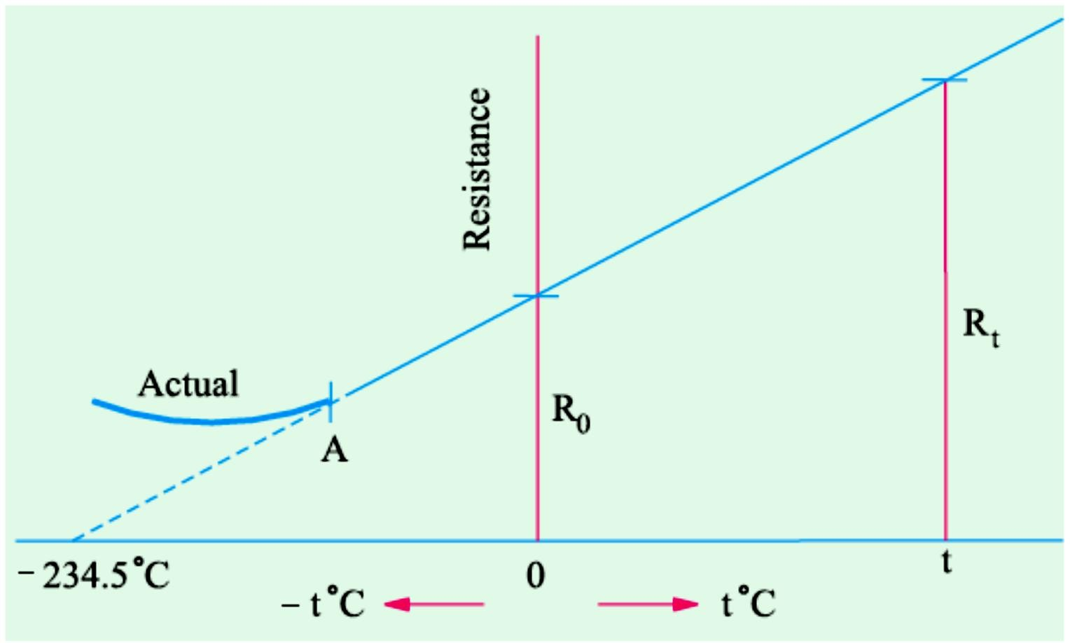
3
In Fig. 2.2 is shown the temperature/resistance graph for copper and is practically a straight line. If this line is extended backwards, it would cut the temperature axis at a point where temperature is − 234.5°C (a number quite easy to remember). It means that theoretically, the resistance of copper conductor will become zero at this point though as shown by solid line, in practice, the curve departs from a straight line at very low temperatures. From the two similar triangles of Fig. 2.2 it is seen that:
𝑅_{𝑡 =} 𝑡 + 234.5 ₌ ₍₁ ₊ 𝑡
)
𝑅₀ 234.5 234.5
𝑅_{𝑡} = 𝑅₀ (1 +
𝑡
) 𝑜𝑟 𝑅_{𝑡} = 𝑅₀(1 + 𝛼𝑡) 𝑤ℎ𝑒𝑟𝑒 𝛼 =
1
𝑓𝑜𝑟 𝑐𝑜𝑝𝑝𝑒𝑟
234.5
234.5
Fig. 2.2
2-4 Value of α at Different Temperatures
So far we did not make any distinction between values of α at different
temperatures. But it is found that value of α itself is not constant but depends on the initial temperature on which the increment in resistance is based. When the increment is based on the resistance measured at 0°C,

Slide 4
4
then α has the value of 𝛼₀. At any other initial temperature t°C, value of α is 𝛼_{𝑡} and so on. It should be remembered that, for any conductor, 𝛼₀ has the maximum value.
Suppose a conductor of resistance 𝑅₀ at 0°C (point A in Fig. 2.3) is heated to t°C (point B). Its resistance 𝑅_{𝑡} after heating is given by
𝑹_{𝒕} = 𝑹_{𝟎}(𝟏 + 𝜶_{𝟎} 𝒕) (𝒊)
Where 𝛼₀ is the temperature-coefficient at 0°C.
Now, suppose that we have a conductor of resistance 𝑅_{𝑡} at temperature t°C. Let this conductor be cooled from t°C to 0°C. Obviously, now the initial point is B and the final point is A. The final resistance 𝑅₀ is given in terms of the initial resistance by the following equation
𝑹_{𝟎} = 𝑹_{𝒕} [𝟏 + 𝜶_{𝒕}(−𝒕)] = 𝑹_{𝒕}(𝟏 − 𝜶_{𝒕} 𝒕) (𝒊𝒊)
From Eq. (ii) above, we have 𝛼
𝑡
₌ 𝑅_{𝑡}−𝑅₀
𝑅_{𝑡}×𝑡
Substituting the value of 𝑅_{𝑡} from Eq. (i), we get
𝑹_{𝟎}(𝟏 + 𝜶_{𝟎}𝒕) − 𝑹_{𝟎} 𝜶_{𝟎}
𝜶_{𝟎}
𝜶_{𝒕} = ∴ 𝜶 =
… (𝒊𝒊𝒊)
𝑹 (𝟏 + 𝜶 𝒕) × 𝒕 ⁼ 𝟏 + 𝜶 𝒕
𝒕
𝟏 + 𝜶 𝒕
𝟎 𝟎 𝟎 𝟎
In general, let 𝛼₁ = tempt. coeff. at 𝑡₁°C ; 𝛼₂ = tempt. coeff. at 𝑡₂°C. Then from Eq. (iii) above, we get
𝛼 =
𝛼₀
𝑜𝑟
1 1 + 𝛼₀ 𝑡₁
𝛼 ⁼ 𝛼
1 0
1
1 + 𝛼₀ 𝑡₁
Similarly,
1 ₌ 1 + 𝛼₀ 𝑡₂
𝛼₂ 𝛼₀
Subtracting one from the other, we get
1 1 1 1
1
𝛼
2
− _{𝛼} = (𝑡₂ − 𝑡₁)𝑜𝑟 _{𝛼} = _{𝛼} + (𝑡₂ − 𝑡₁)𝑜𝑟 𝛼₂ = _{1⁄𝛼}
+ (𝑡 − 𝑡 )
1
2
1 1
2 1

Slide 5
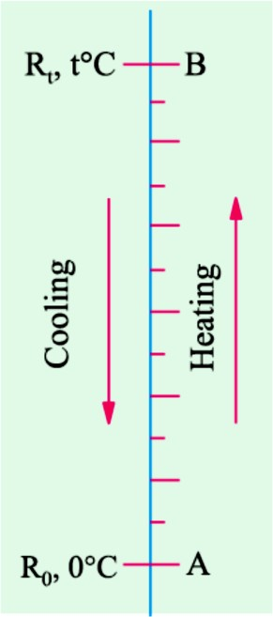
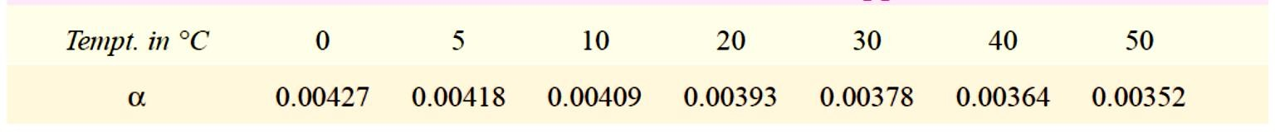
5
Fig. 2.3
Values of α for copper at different temperatures are given in Table No. 2.2.
Table 2.2. Different values of α for copper
In view of the dependence of α on the initial temperature, we may define
the temperature coefficient of resistance at a given temperature as the charge in resistance per ohm per degree centigrade change in temperature from the given temperature.
In case 𝑅₀ is not given, the relation between the known resistance 𝑅₁ at
𝑡₁°C and the unknown resistance 𝑅₂ at 𝑡₂°C can be found as follows:
𝑅₂ = 𝑅₀(1 + 𝛼₀𝑡₂) 𝑎𝑛𝑑 𝑅₁ = 𝑅₀(1 + 𝛼₀𝑡₁)
𝑹_{𝟐} 𝟏 + 𝜶_{𝟎}𝒕_{𝟐}
(𝑖𝑣)
𝑹 ⁼ 𝟏 + 𝜶 𝒕
𝟏 𝟎 𝟏
Or 𝑹_{𝟐} = 𝑹_{𝟏}[𝟏 + 𝜶_{𝟎}(𝒕_{𝟐} − 𝒕_{𝟏})]

Slide 6
6
2-5 Variations of Resistivity with Temperature
Not only resistance but specific resistance or resistivity of metallic conductors also increases with rise in temperature.
As seen from Fig. 2.4 the resistivities of metals vary linearly with temperature over a significant range of temperature-the variation becoming non-linear both at very high and at very low temperatures. Let, for any metallic conductor,
𝜌₁ = resistivity at 𝑡₁°C
𝜌₂ = resistivity at 𝑡₂°C
𝑚 =Slope of the linear part of the curve Then, it is seen that
𝜌₂ − 𝜌₁
𝑚 =
𝑡₂ − 𝑡₁
𝜌 𝑚
2
Or 𝜌 = 𝜌 + 𝑚(𝑡 − 𝑡 ) or = 1 + (𝑡 − 𝑡 )
2 1 2 1 2 1
𝜌₁ 𝜌₁
The ratio of 𝑚⁄𝜌₁ is called the temperature coefficient of resistivity at temperature𝑡₁°C. It may be defined as numerically equal to the fractional change in 𝜌₁ per °C change in the temperature from 𝑡₁°C. It is almost equal to the temperature-coefficient of resistance 𝛼₁. Hence, putting 𝛼₁ =
𝑚⁄𝜌₁, we get
𝝆_{𝟐} = 𝝆_{𝟏}[𝟏 + 𝜶_{𝟏}(𝒕_{𝟐} − 𝒕_{𝟏}) 𝒐𝒓 𝒔𝒊𝒎𝒑𝒍𝒚 𝒂𝒔 𝝆_{𝒕} = 𝝆_{𝟎}(𝟏 + 𝜶_{𝟎}𝒕)

Slide 7
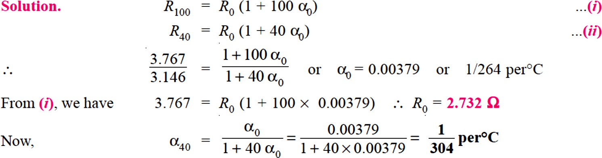
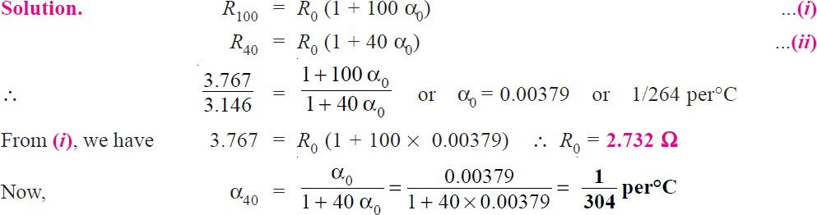
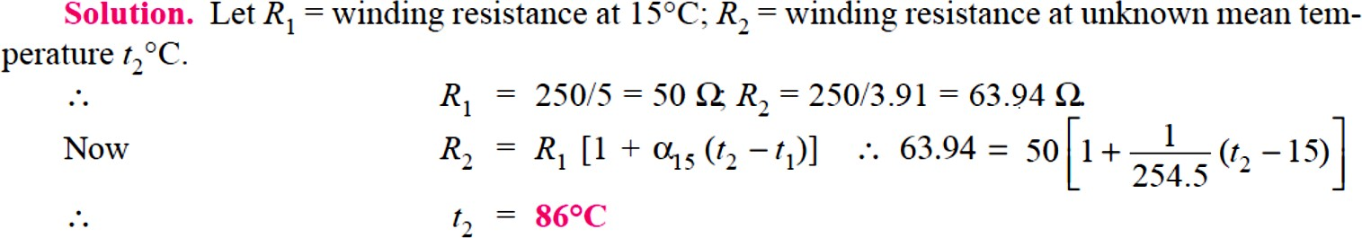
7
Example 1. A copper conductor has its specific resistance of 1.6 × 10⁻⁶ ohm-cm at 0°C and a resistance temperature coefficient of 1/254.5 per °C at 20°C. Find (i) the specific resistance and (ii) the resistance - temperature coefficient at 60°C.
Example 2. A platinum coil has a resistance of 3.146 Ω at 40°C and 3.767 Ω at 100°C. Find the resistance at 0°C and the temperature- coefficient of resistance at 40°C.
Example 3. A potential difference of 250 V is applied to a field winding at 15°C and the current is 5 A. What will be the mean temperature of the winding when current has fallen to 3.91 A, applied voltage being constant. Assume 𝛼₁₅ = 1⁄254.5.

Slide 8
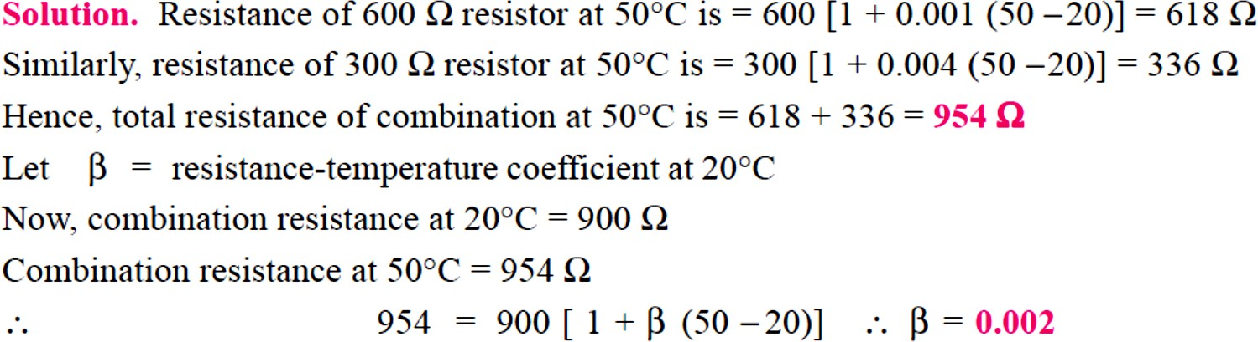
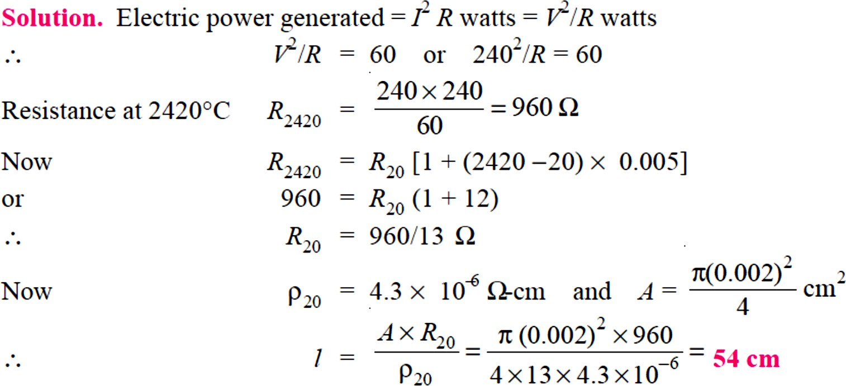
8
Example 4. Two coils connected in series have resistances of 600 Ω and 300 Ω with tempt. coeff. of 0.1% and 0.4% respectively at 20°C. Find the resistance of the combination at a tempt. Of 50°C. What is the effective tempt. coeff. of combination ?
Example 5. The filament of a 240 V metal-filament lamp is to be constructed from a wire having a diameter of 0.02 mm and a resistivity at 20°C of 4.3 μΩ-cm. If α = 0.005/°C, what length of filament is necessary if the lamp is to dissipate 60 watts at a filament tempt. of 2420°C ?

Slide 9
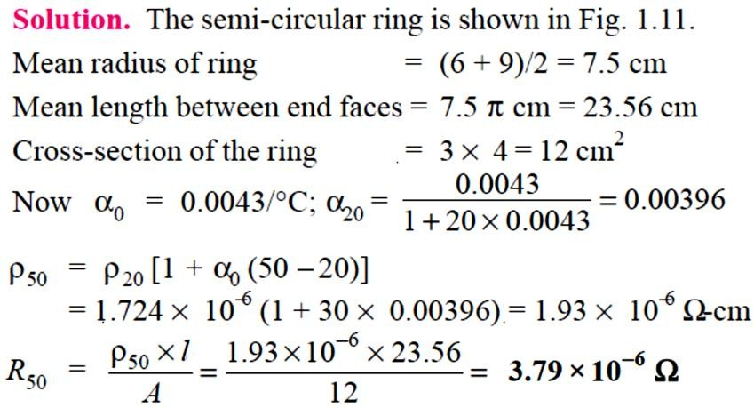
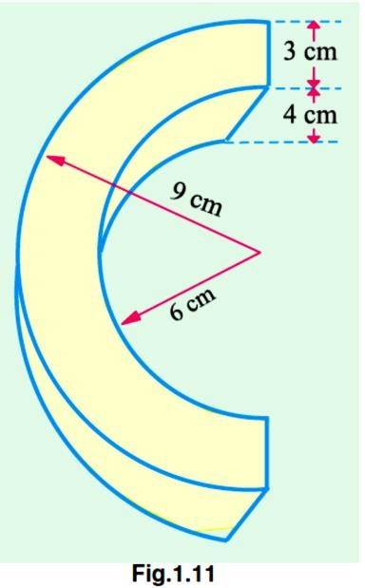
9
Example 6. A semi-circular ring of copper has an inner radius 6 cm, radial thickness 3 cm and an axial thickness 4 cm. Find the resistance of the ring at 50°C between its two end-faces. Assume specific resistance of Cu at 20°C = 1.724 × 10−6 ohm-cm and resistance tempt. coeff. of Cu at 0°C = 0.0043/°C.

